Slide 1

Spotify Data Analysis
By Eva Beyebach & Makayla Childs
Group 8

Slide 2
Introduction
The Spotify Dataset comes from Spotify via the spotifyr package.
This package was authorized to make it easier to get either your own data or general metadata around songs from Spotify's API.
We want to answer the questions:
What characteristics of a song can determine its popularity?
Which genres and subgenres predict popularity of the songs?
Data Preparation, EDA and Modelling.
Linear Regression, KNN, Logistic Regression, SVM and Tree Models.
Spotify will be able to provide more accurate predictions of a new song's potential popularity.

Slide 3
Variable Name | Description
track_id | unique ID
track_name | Song Name
track_artist | Song Artist
track_popularity | Song Popularity (0-100) where higher is better
track_album_id | Album unique ID
track_album_name | Song album name
track_album_release_date | Date when album released
playlist_name | Name of playlist
playlist_id | Playlist ID
playlist_genre | Playlist genre
playlist_subgenre | Playlist subgenre
danceability | Danceability describes how suitable a track is for dancing based on a combination of musical elements. A value of 0.0 is least danceable and 1.0 is most danceable.
energy | Energy is a measure from 0.0 to 1.0 and represents a perceptual measure of intensity and activity.
key | The estimated overall key of the track. Integers map to pitches using standard Pitch Class notation .
loudness | The overall loudness of a track in decibels (dB).
mode | Mode indicates the modality (major or minor) of a track
speechiness | Speechiness detects the presence of spoken words in a track.
acousticness | A confidence measure from 0.0 to 1.0 of whether the track is acoustic. 1.0 represents high confidence the track is acoustic.
instrumentalness | Predicts whether a track contains no vocals.
liveness | Detects the presence of an audience in the recording. Higher liveness values represent an increased probability that the track was performed live. A value above 0.8 provides strong likelihood that the track is live.
valence | A measure from 0.0 to 1.0 describing the musical positiveness conveyed by a track. Tracks with high valence sound more positive.
tempo | The overall estimated tempo of a track in beats per minute (BPM).
duration_ms | Duration of song in milliseconds

Slide 4
Packages Required
Tidyverse: assists with data import, tidying, manipulation, and data visualization.
ggplot2: package for producing statistical, or data, graphics.
kknn: performs k-nearest neighbor classification.
corrplot: graphical display of a correlation matrix, confidence interval.
readr: provides a fast way to read rectangular data.
rpart: implements the classification and regression tree algorithm (CART).
rpart.plot: An Enhanced Plotting Package for rpart.

Slide 5
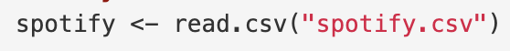
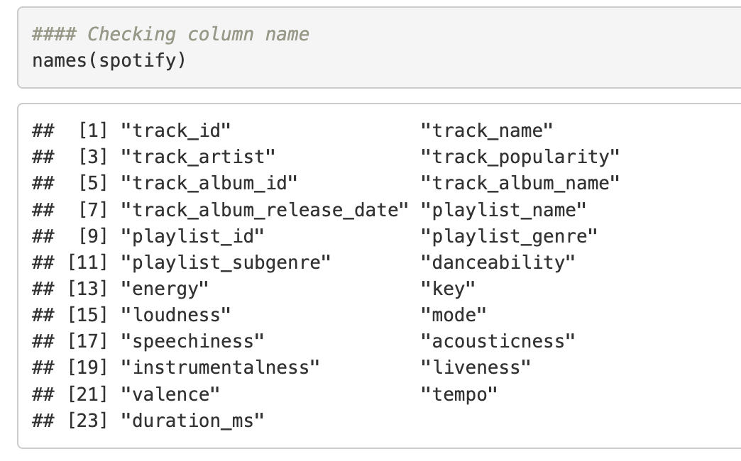
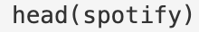
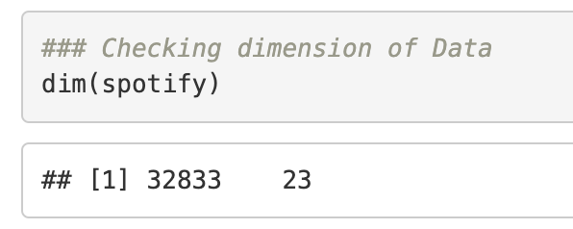
Data Preparation
Data loading:
Data Examination:

Slide 6
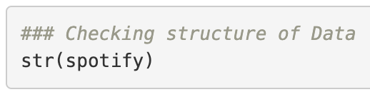
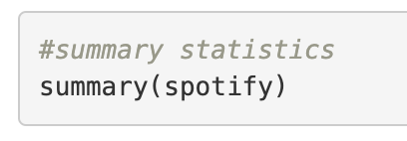
Data Cleaning
2
We need to change track_album_release_date from chr to date variable
We will also change playlist_genre from chr to factor, for future plotting
Summary() displays : Min, Q1, Median, Mean, Q3 and Max of each variable
We can see that there are probably some outliers
duration_ms has a Max of 517810
tempo has a Max of 239.44
Since track_popularity is continuous we assume lm and regression trees are the best model

Slide 7
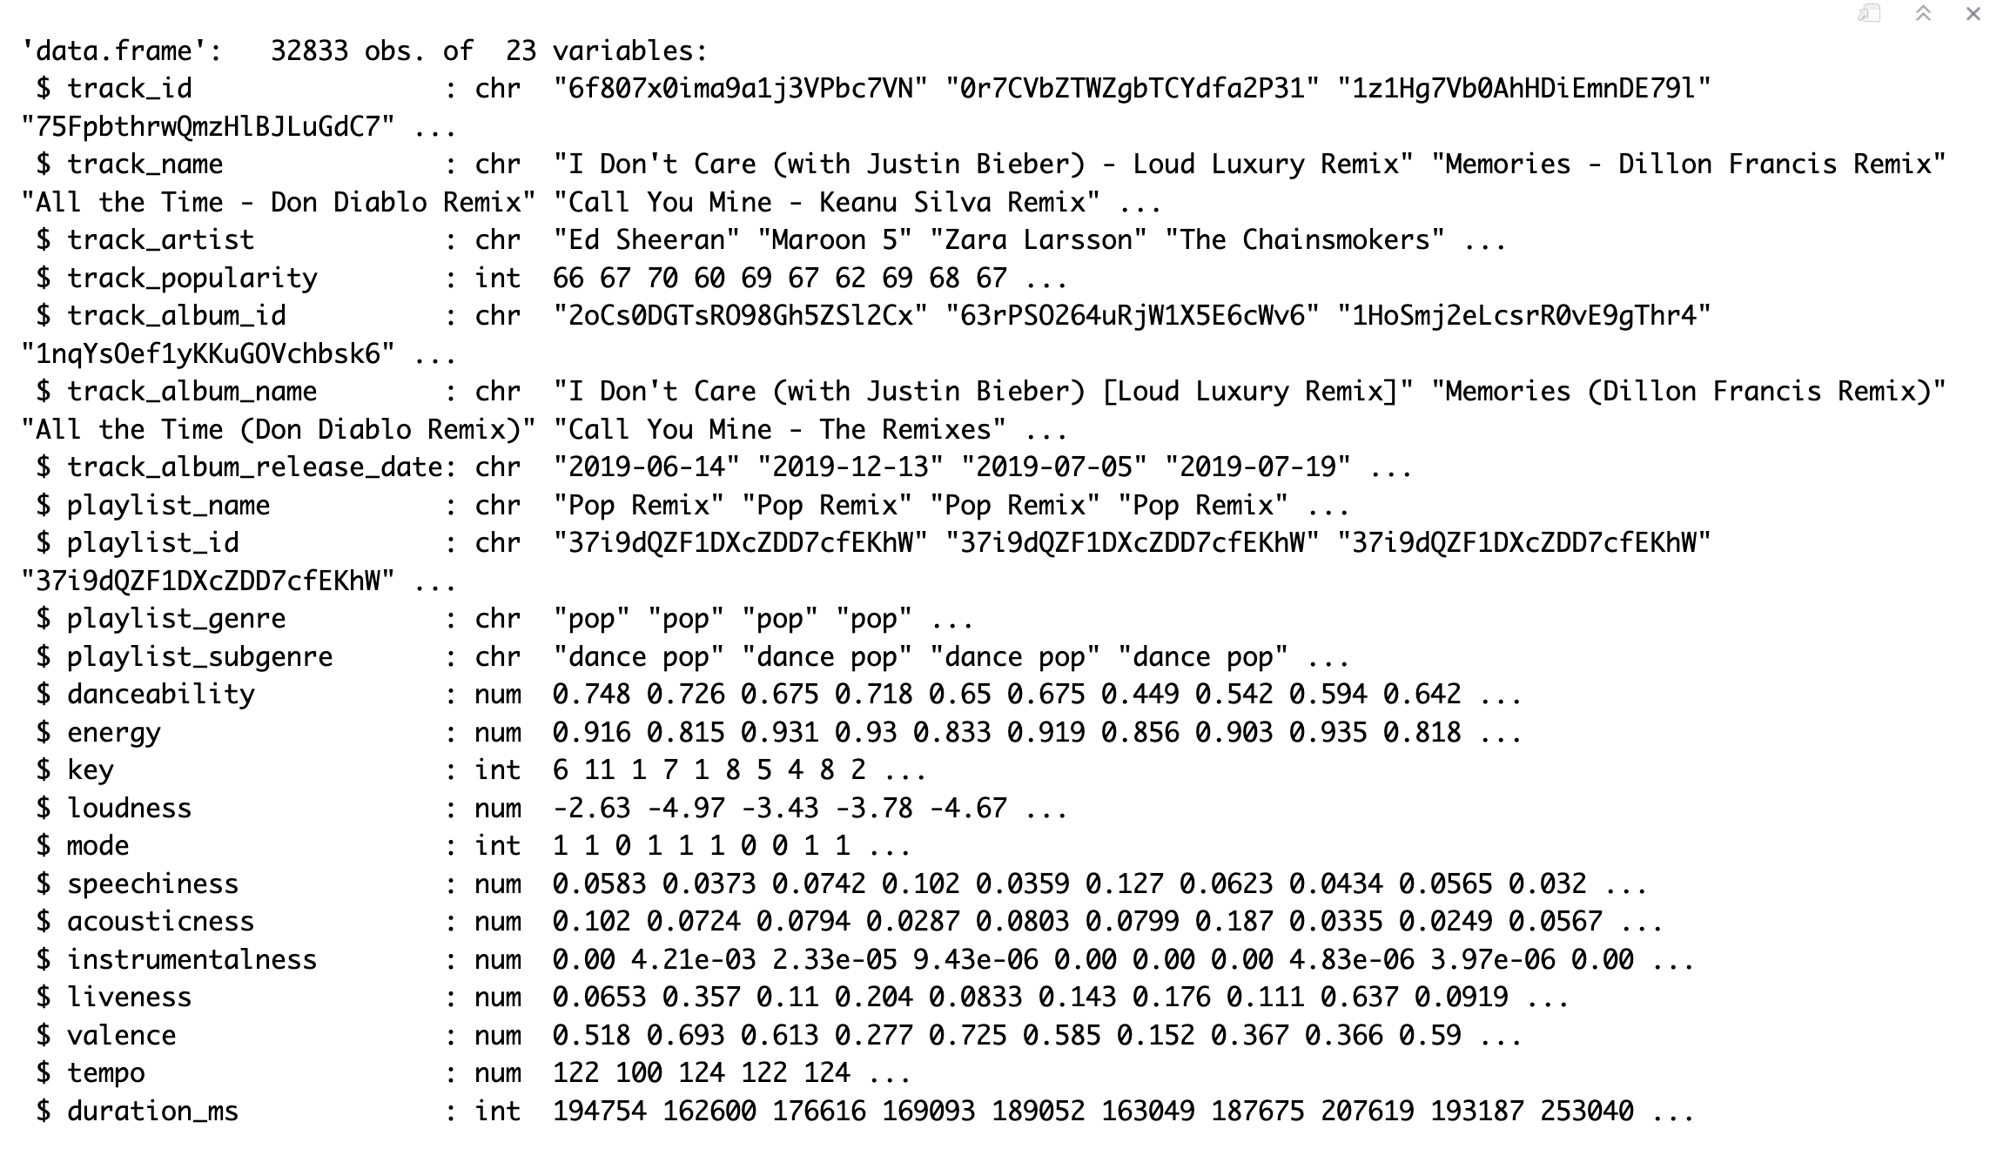
STR()

Slide 8
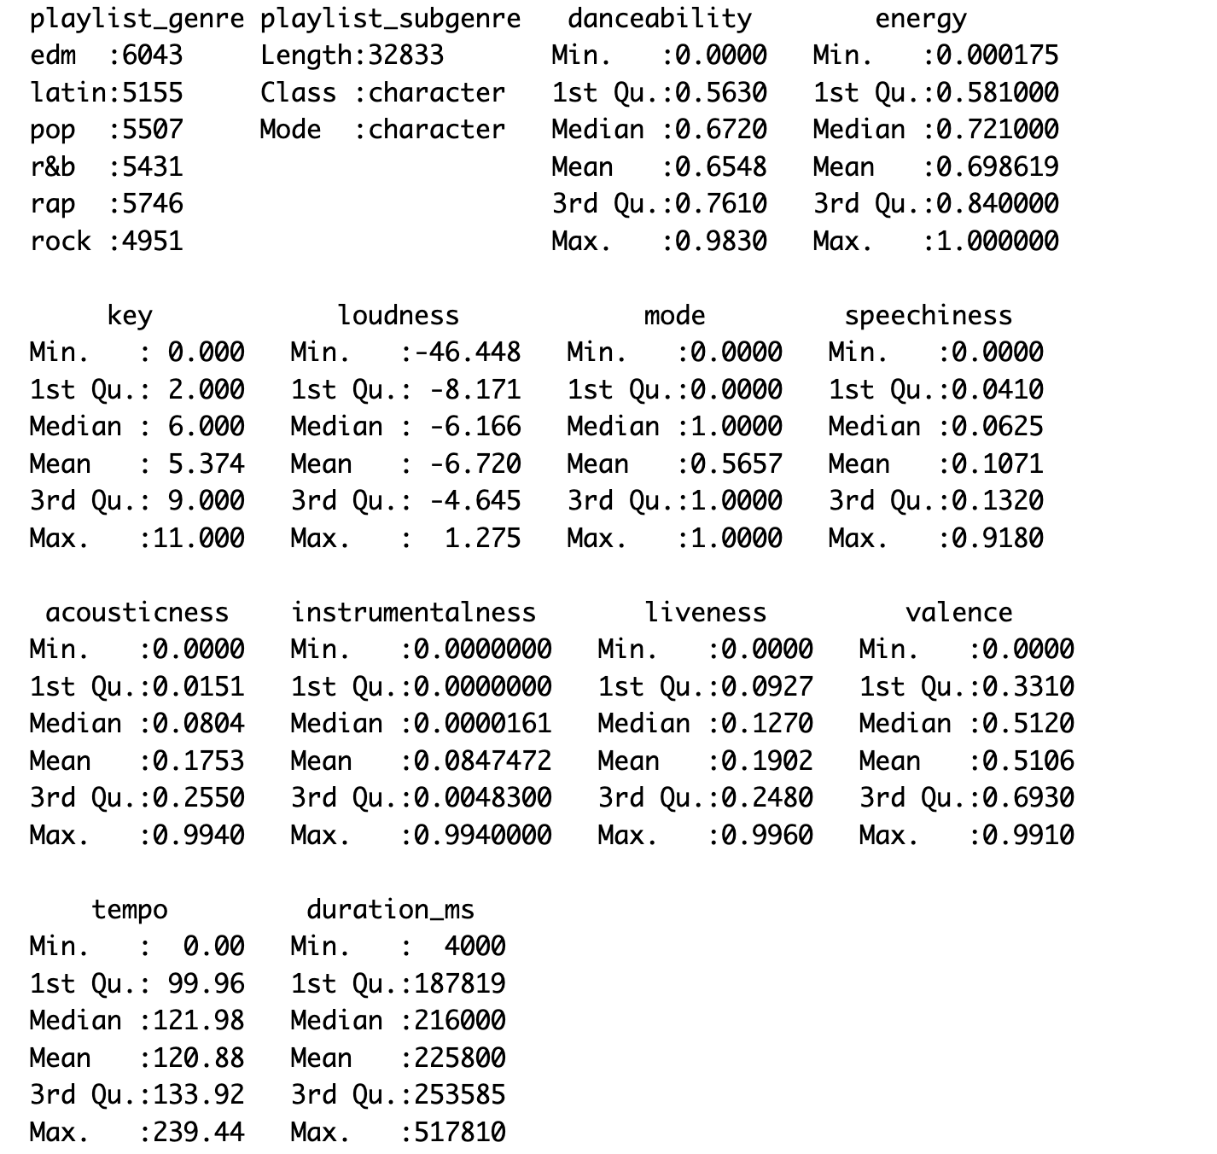
SUMMARY()

Slide 9
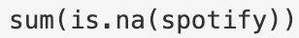
Data Cleaning
Duplicates :
4477 observations have duplicates on track_id
We remove them
Missing values:
1693 missing values in this dataset
We will not remove them

Slide 10
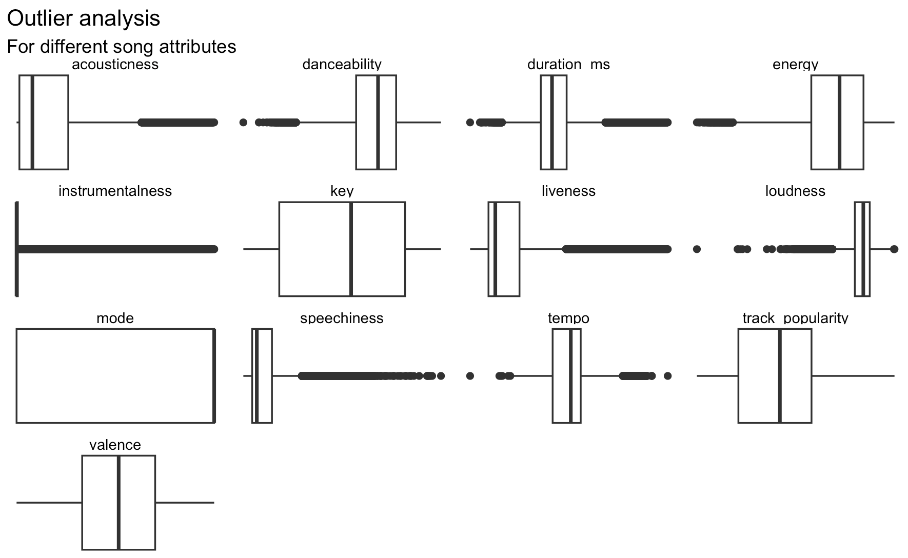
Data Cleaning
Visual Boxplot exploration to identify outliers
We will truncate energy speechiness, acousticness, instrumentalness and liveness
We will winsorize loudness, tempo and duration

Slide 11
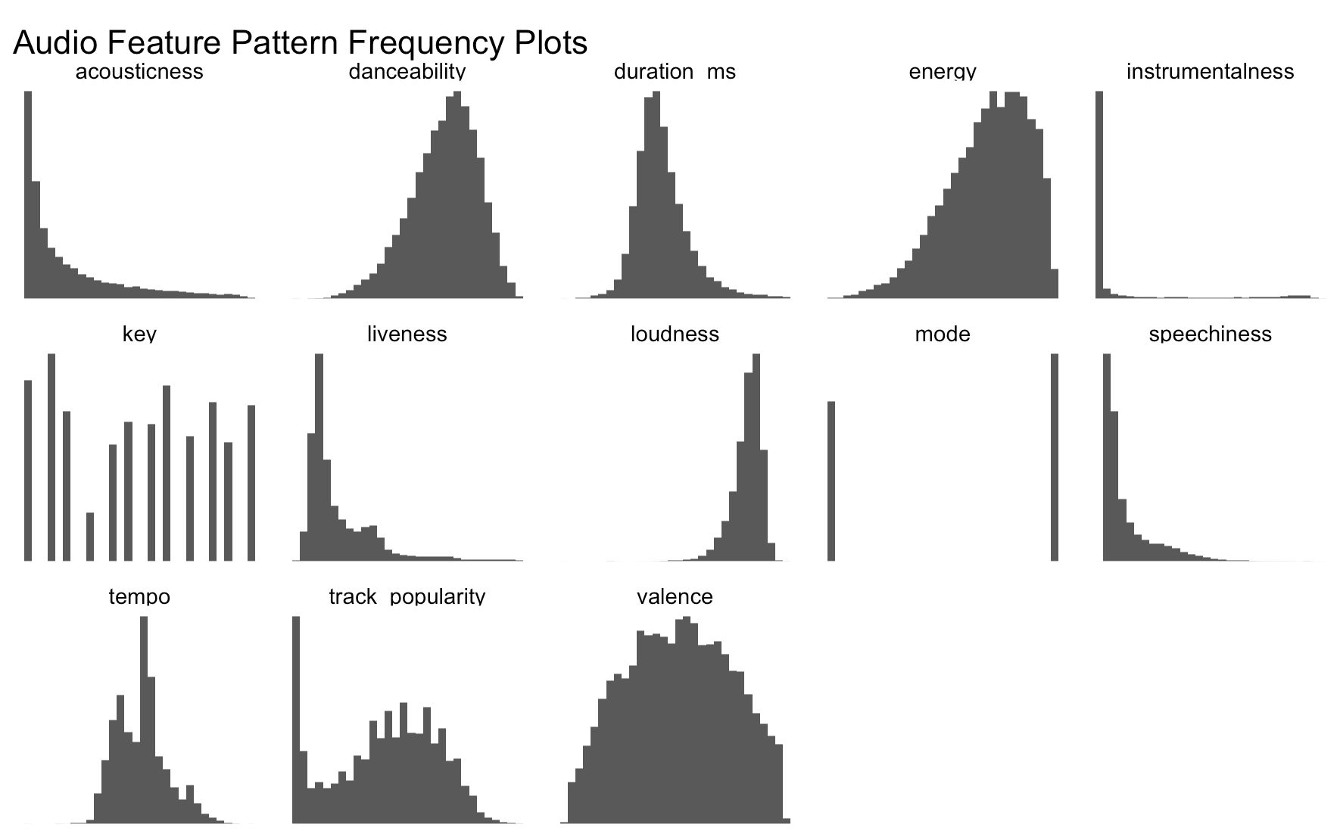
Exploratory Data Analysis
Visual histogram exploration to understand the data set
Duration , Valence and tempo are normally distributed
Danceability, Energy and Loudness are left-skewed
Acousticness, Liveness and Speechiness are right-skewed
In track_popularity the max is around 50-60, and it is normally distributed. There are a lot of zero values, possible missing values or outliers

Slide 12
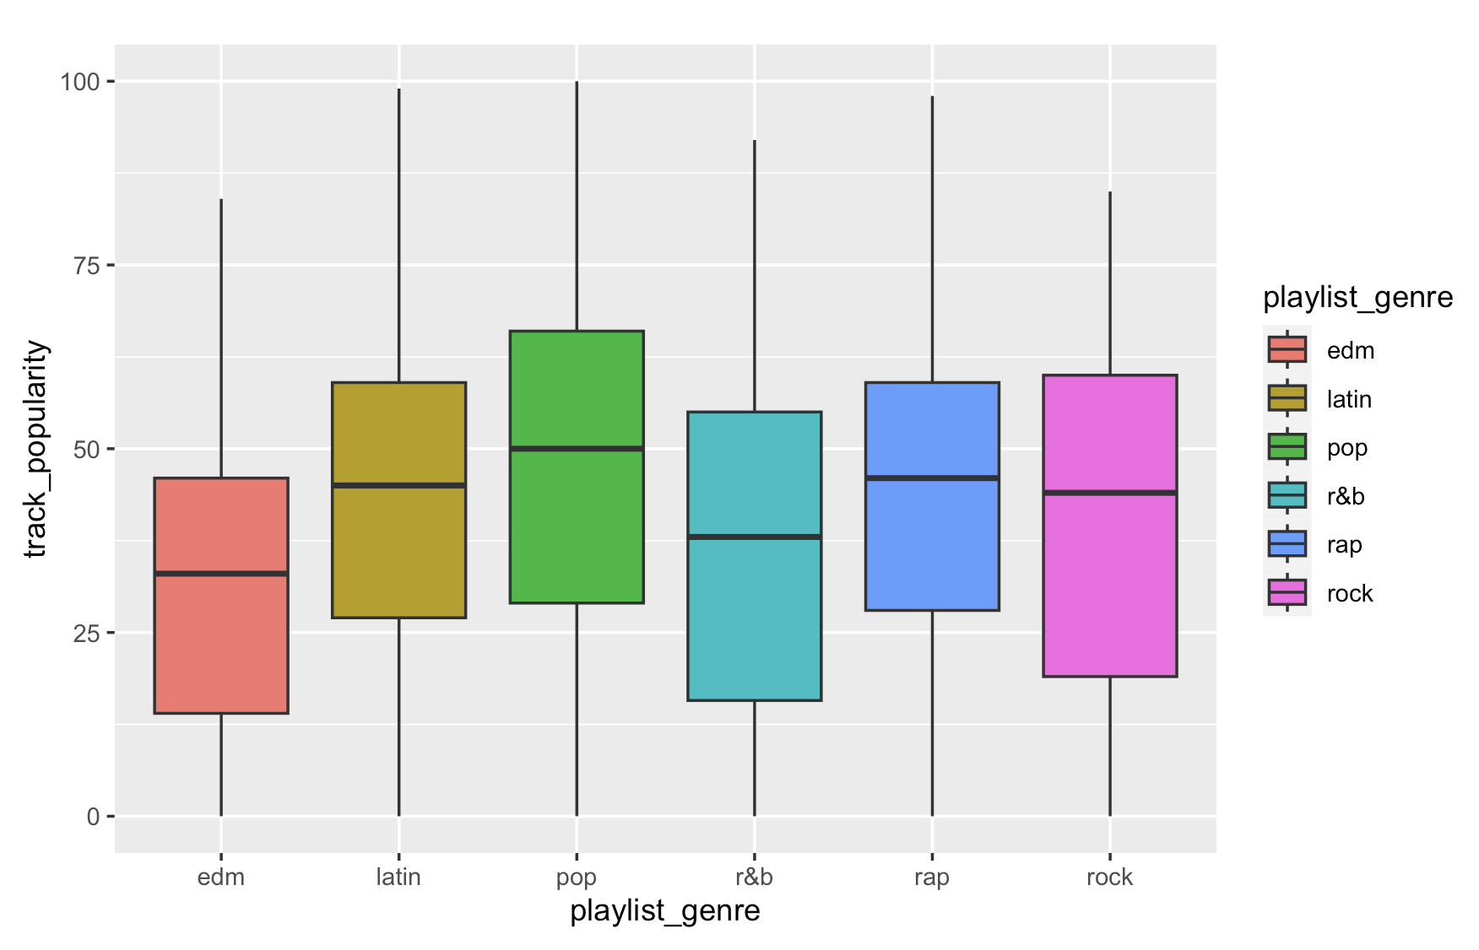
Exploratory Data Analysis
Boxplot to plot different genres vs popularity
Pop is the most popular genre
Followed by latin and rock

Slide 13
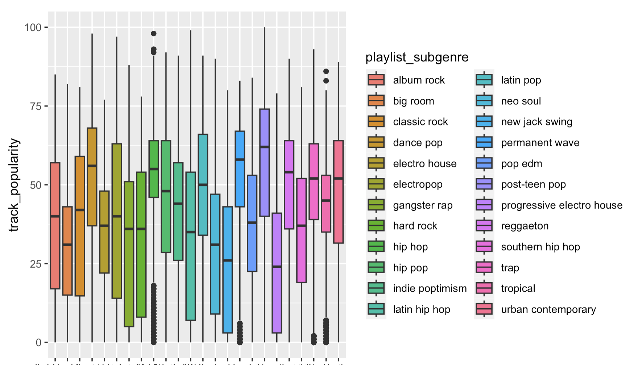
Exploratory Data Analysis
Boxplot to plot different subgenres vs popularity
Post-Teen-Pop is the most popular subgenre
Followed by Dance-Pop and Permanent-Wave

Slide 14
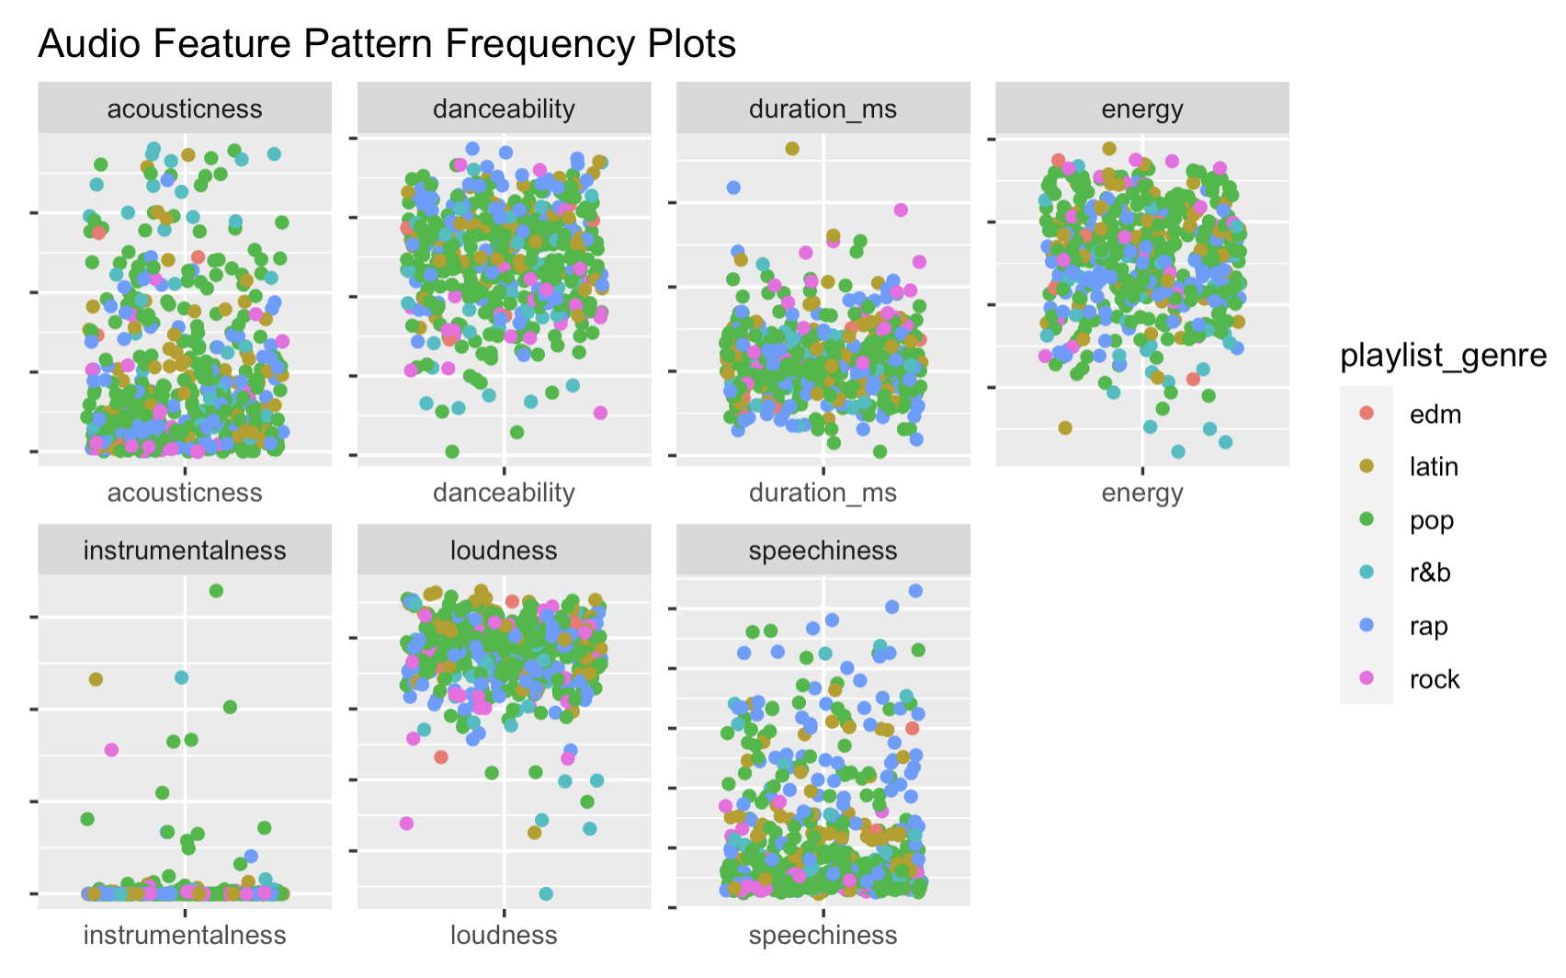
Exploratory Data Analysis
Scatterplots comparing parameters to popularity
These graphics contain data from the 500 most popular songs
Since Instrumentalness, Speechiness and Loudness have a smaller interval, we would consider them to best predict track_popularity.

Slide 15
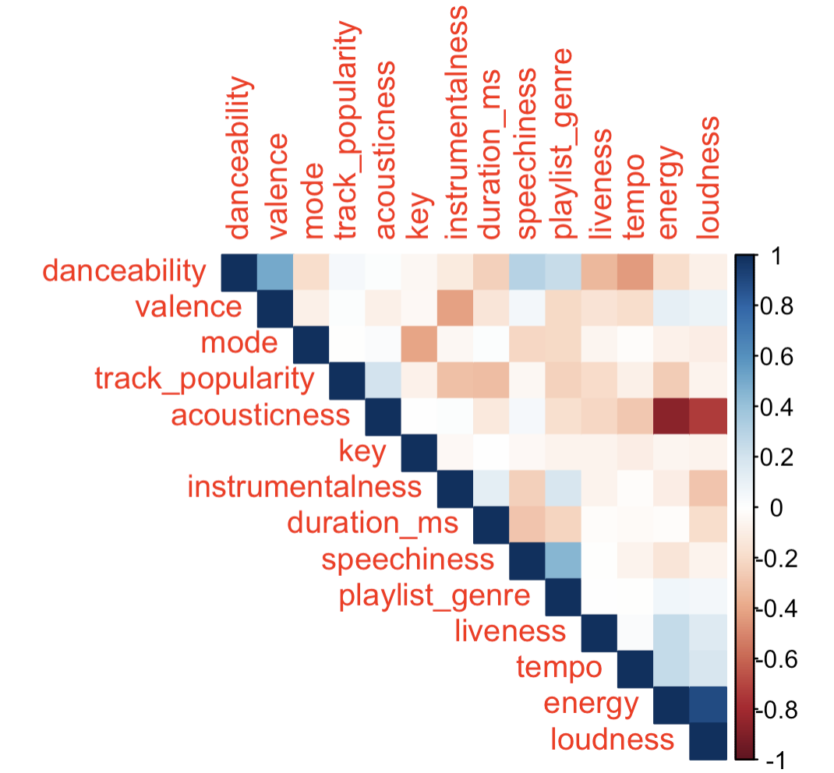
Exploratory Data Analysis
Correlation Plot
The variables that mostly correlate with track_popularity are the following:
1. Duration (-0.1396)
2. Instrumentalness (-0.1244)
3. Energy (-0.1036)
4. Acousticness (0.0917)
5. playlist_genre (-0.0734)

Slide 16
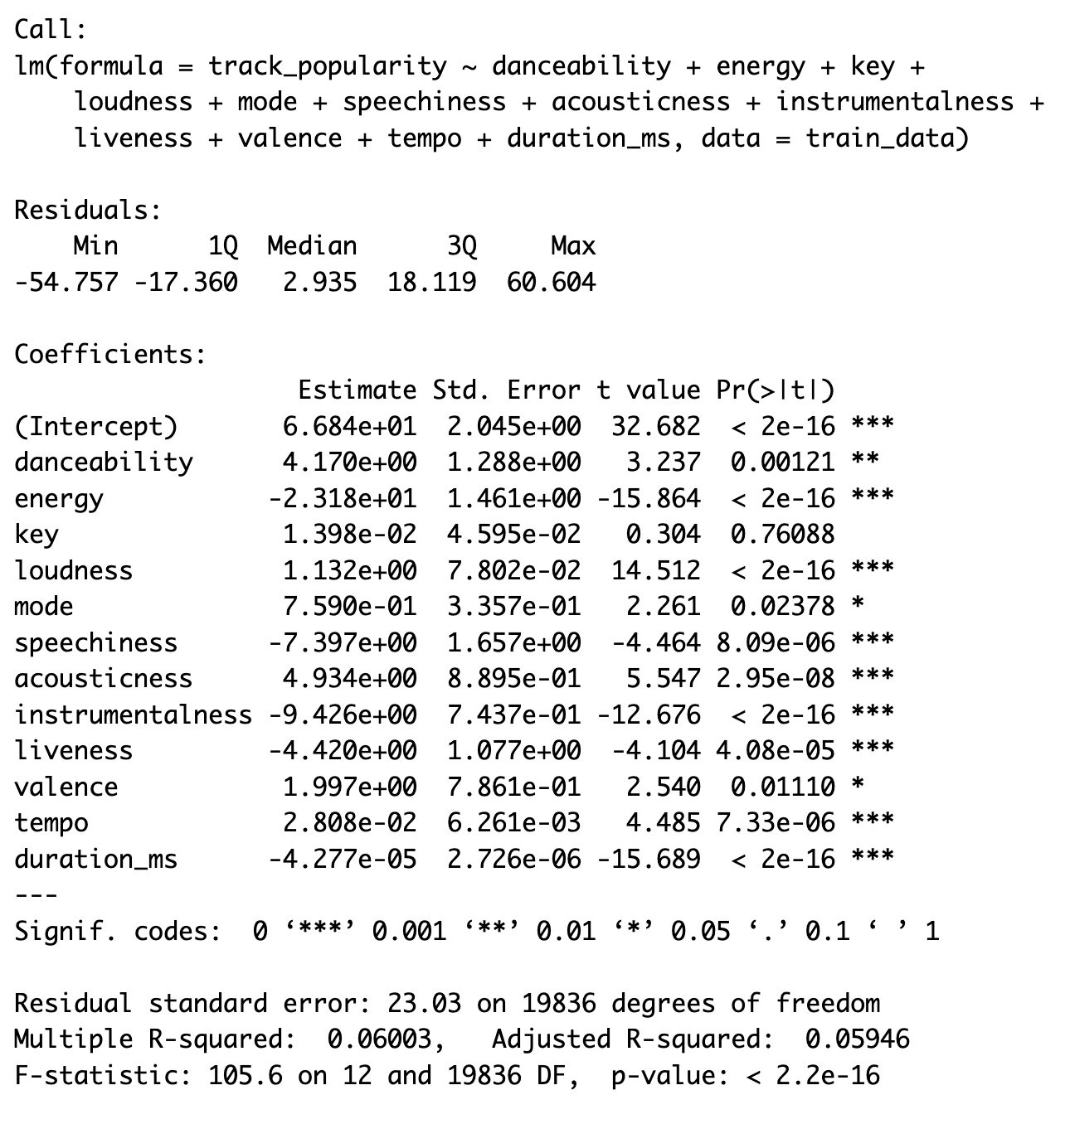
Modelling
1st Linear Regression Model
We first split the data into training (70%) and testing set (30%)
We build regression model with continuous variables
All variables are significant, except Key
Low R^2 = 0.06003 , only 6% of the of the data’s variability can be explained by the regression model
instrumentalness, speechiness and duration_ms have highest coefficients
Training MSE= 529.94; Testing MSE= 527.51

Slide 17
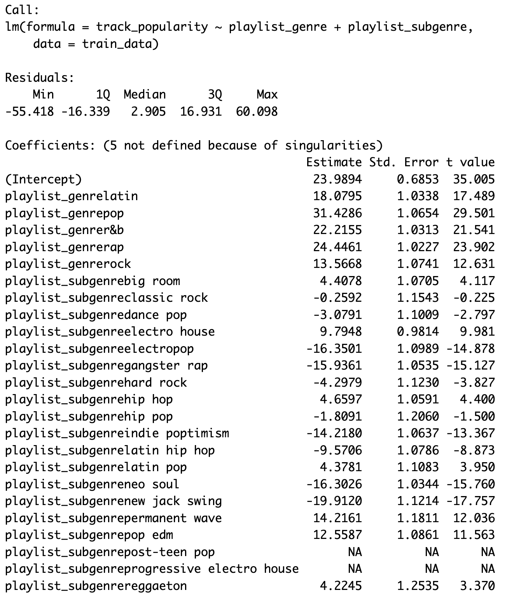
Modelling
2nd Linear Regression Model
We build regression model with categorical variables
Genre and Subgenre
All variables are significant, except classic rock and hip hop
Bigger R^2 = 0.1362 , 13.62% of the of the data’s variability can be explained by the regression model
pop, rap , r&b , jack swing, electropop and neo soul have highest coefficients
Training MSE= 486.43; Testing MSE= 485.8

Slide 18
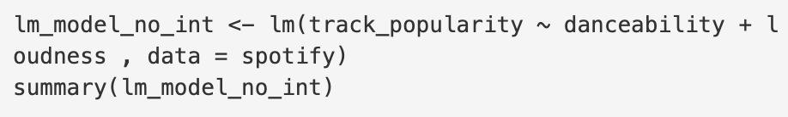
Modelling: Linear Models
3rd Model (with interaction)
4th Model (no interaction)
Lower R^2 = 0.004887
Interaction and variables are significant
Training MSE= 567.09
Testing MSE= 554.33
R^2 = 0.003439
Both variables are significant
Training MSE= 566.13
Testing MSE= 555.23

Slide 19
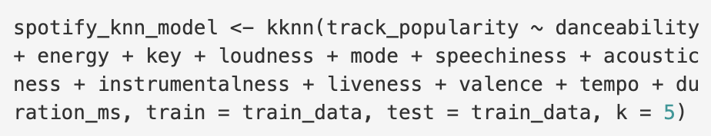
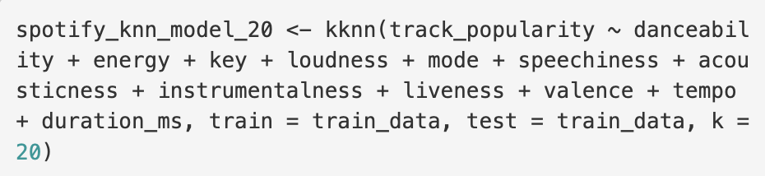
Modelling: KNN
1st Model (k=5)
2nd Model (k=20)
Training MSE= 389.061
Testing MSE= 556.982
Training MSE= 194.904
Testing MSE= 687.024

Slide 20
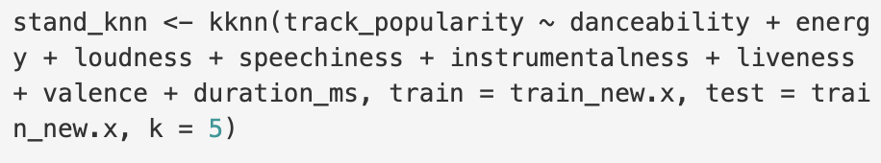
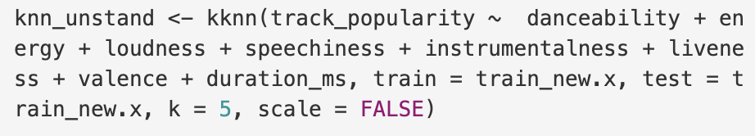
Modelling: KNN > Different Variables
3rd Model (k=5; unstandardized)
4th Model (k=5; standardized)
Training MSE= 217.942
Testing MSE= 213.310
Training MSE= 206.747
Testing MSE= 201.450

Slide 21
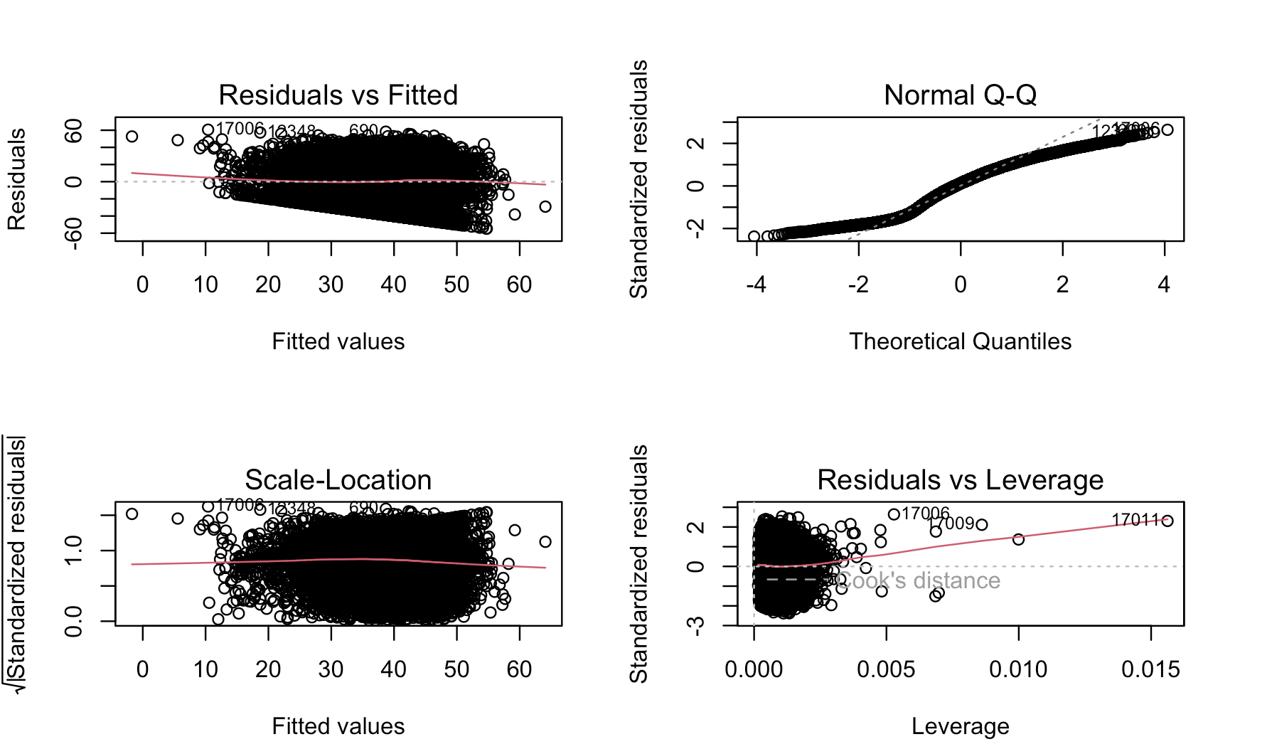
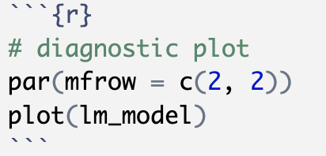
Modelling
Diagnostic Plots
From the diagnostic plot, we see that the model does not meet all four assumptions
linear regression model is not the best fit for this data.

Slide 22
Modelling
Comparing Results
 | Lm 1 (Cont) | Lm 2 (Cat) | Lm 3 (Int) | Lm 4 (No Int) | Knn (k=5) (Cont) | Knn (k=20) (Cont) | Knn(k=5) (diff. var) / unst. | Knn(k=5) (diff. var) / stand.
Training MSE | 529.94 | 486.43 | 567.09 | 566.13 | 194.904 | 389.061 | 217.942 | 206.747
Testing MSE | 527.51 | 485.8 | 554.33 | 555.23 | 687.024 | 556.982 | 213.310 | 201.450
Out of the continuous models (with same variables) , LM had the best Out-of-Sample MSE
Out of the continuous models (with same variables), KNN had the best In-Sample MSE (with k=5)
In KNN standardized model performed better, but small difference between both (they have lower MSE , because we used less variables on these models)
Linear Model is still better model that KNN
Smallest Testing MSE
Better for continuous dependent variables

Slide 23
Modelling : Logistic Regression
1st Model (num. var)
For logistic Regression we have to convert track_popularity (dependent variable) to categorical
We are substituting values above 70 with 1 (popular) and below 70 with 0 (unpopular)

Slide 24
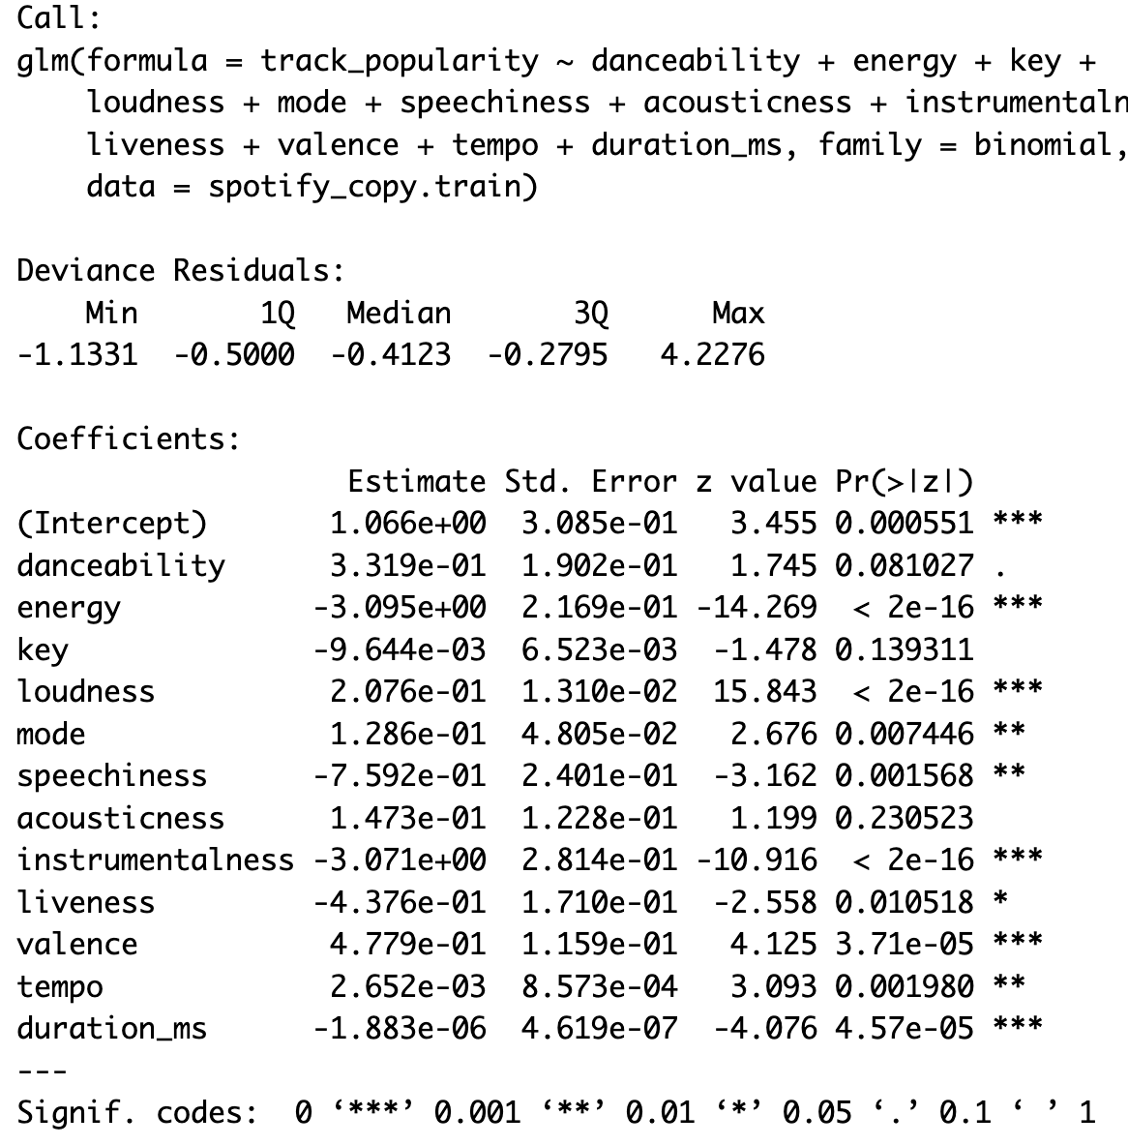
Modelling
1st Model (num. var)
Key, danceability and acousticness are not significant
Key has the highest coefficient with -9.644, followed by speechiness and liveness
Training AUC = 0.6855; Testing AUC = 0.6610
We define optimal p.cut = 0.16
TRAINING
MR:0.1534
FPR:0.08957
FNR:0.7757
cost: 0.4418
TESTING
MR: 0.1523
FPR: 0.0871
FNR: 0.7909
Cost: 0.4457

Slide 25
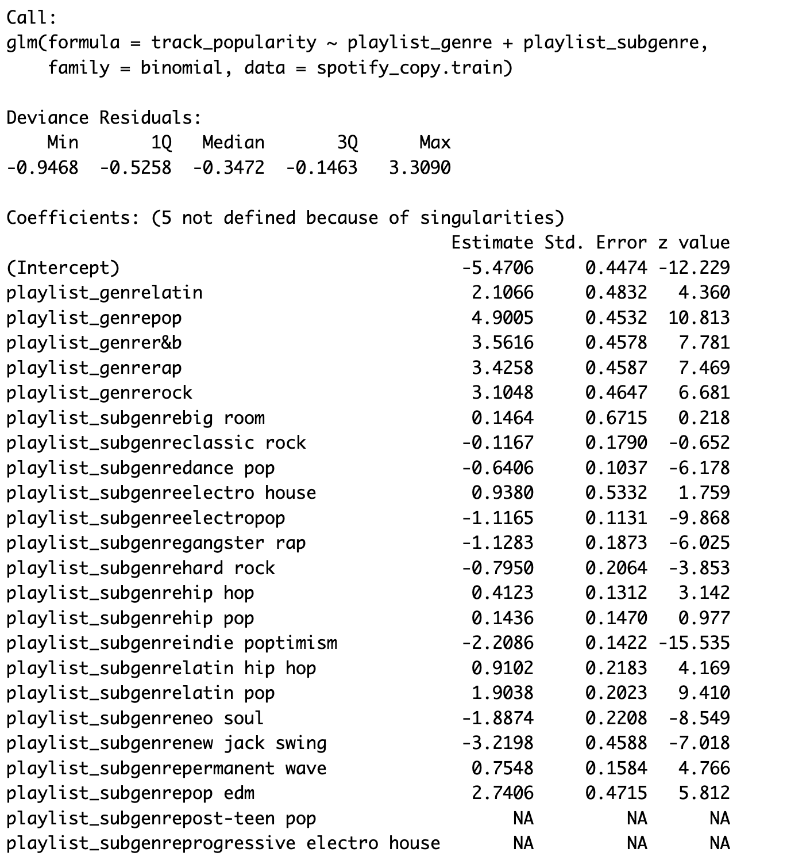
Modelling
2nd Model (cat. var)
big room, classic rock, hip pop, and electro house are not significant
Pop has the highest coefficient with 4.9005, followed by r&b and rap
Training AUC = 0.7594 ; Testing AUC = 0.754
We define optimal p.cut = 0.17
TRAINING
MR:0.1513
FPR:0.1047
FNR: 0.6695
cost: 0.4003
TESTING
MR: 0.1571
FPR: 0.1047
FNR: 0.6692
Cost: 0.4053

Slide 26
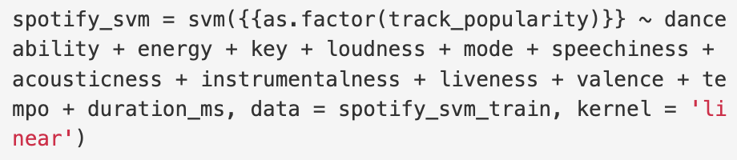
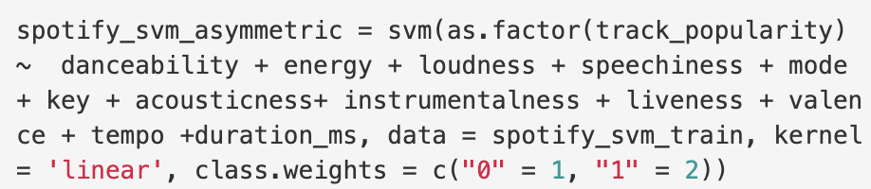
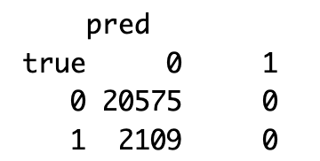
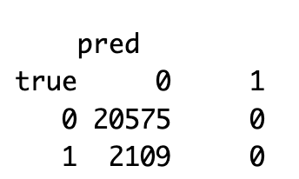
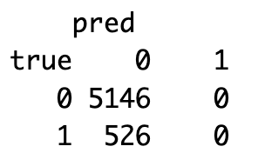
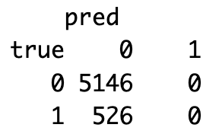
Modelling: SVM
1st Model (no weights and numeric)
2nd Model (weight and numeric)
Training MR= 0.0929
Testing MR= 0.0928
Observations:
Model with weights had better MR and AUC
Training MR= 0.0930
Testing MR= 0.0927
AUC Training = 0.5867
AUC Testing = 0.5699

Slide 27
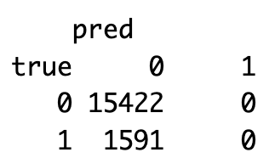
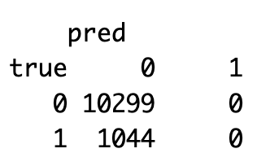
Modelling: Classification Tree
1st Model (no weights)
We also have to convert track popularity into a dummy variable
Split into training and testing data
rpart(as.factor(track_popularity) ~ danceability + energy + speechiness + loudness + instrumentalness+ mode+ key + acousticness+ liveness + valence + tempo, data=spotify_dec.train)
MR Training: 0.0935; MR Testing: 0.0920. AUC Train: 0.5; AUC Test:0.5
Confusion matrix has 0 TP and 0 FP on training & testing data

Slide 28
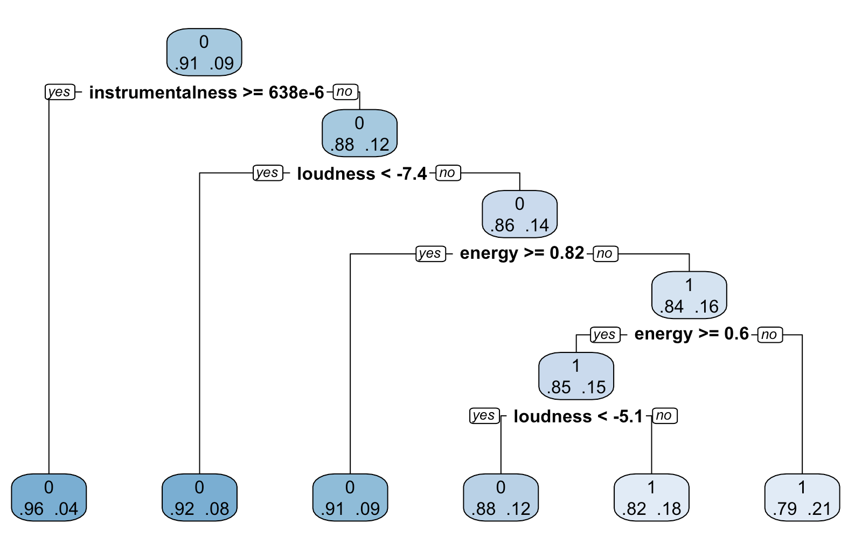
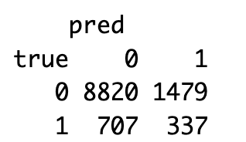
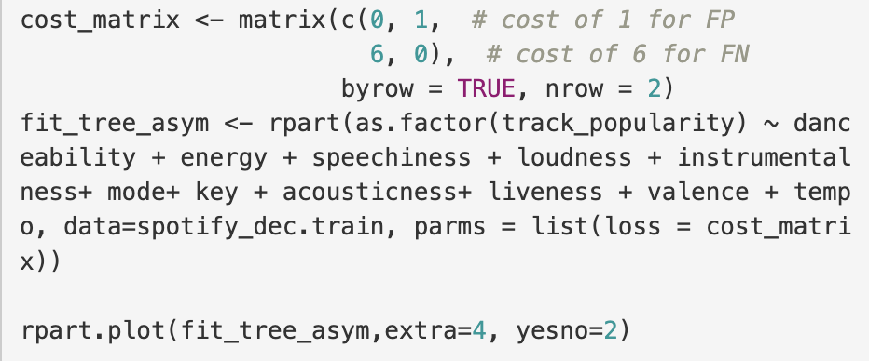
Modelling: Classification Tree
2nd Model (with weights of 1 and 6)
MR Training:0.1951; MR Testing: 0.1927
AUC Train: 0.6614; AUC Test:0. 0.6451
2nd Model had higher MR, but performed better, since it had TP and TN

Slide 29
Conclusion
Comparing All Results
SVM
Logistic Regression
 | Training | Testing
AUC | 0.587 | 0.5909
MR1 | 0.0929 | 0.0928
MR2 | 0.0930 | 0.0927
 | Training | Testing
AUC | 0.6856 | 0.6610
MR | 0.1534 | 0.1523
Observations:
Regression Tree had the best Out-of-Sample MR
Logistic Regression had best AUC
Tree is the best model, since it can handle continuous data as the dependent variable
Regression Tree
 | Training | Testing
AUC 1 | 0.5 | 0.5
AUC 2 | 0.6614 | 0.6451
MR1 | 0.0955 | 0.0920
MR2 | 0.1951 | 0.1927

Slide 30
Conclusion
Comparing All Results
Final Thoughts:
Tree is the best model out of the last three models
LM performs better than KNN
Tree is best one, since LM does not fit four assumptions and overfits data (based on residual plots)
Best Track Popularity predictors:
Plots and Models agree that instrumentallness, speechiness and liveness are the variables that best predict popularity
Pop and dance pop are the genre and subgenre that predicts popularity the most
From linear and logistic models, key is not significant and does not influence in a songs popularity

